Slide 1

FYP Final Defense
Sensor Integrated System based Real Time and Online Monitoring for Organ on Chip platforms
Group member 1:
Wakeel Ahmed (033-19-0026)
Group member 2:
Muhammad Saqlain (033-20-0011)
Group member 3:
Faizan Ahmed (033-20-0032)
Supervisor:
Dr. Fida Hussain Memon

Slide 2
Outline
Introduction
Problem Statement
Proposed Solution
Block Diagram
Objectives
Methodology
Sensor & PCB Data Processing
Hardware & Software Components
Implementation & Testing
Front View of LABVIEW
Schematic Diagram Of LABVIEW
Results & Data Analysis
Future Work
Bill of Materials (BOM)
References

Slide 3
Introduction
This project is about creating a real-time system to monitor Organ-on-Chip (OoC) platforms.
This device acts like a human organ and helps to test drug without using animals.
Our system uses sensors, a custom PCB, NI myRIO, and cloud storage to collect and monitor data online.
The goal is to build a smart monitoring system that can be used for drug test.

Slide 4
Problem statement
Validation of new drugs require platforms to ensure safety and intended result before clinical trials (Stem cells).
Traditional methods of drug testing (experimentation on animals (e.g., mice), face increasing ethical and legal restrictions
Proposed Solution
To design and develop sensor based micro physiological platform to measure the organ on chip parameters like disease modelling and drug testing.

Slide 5
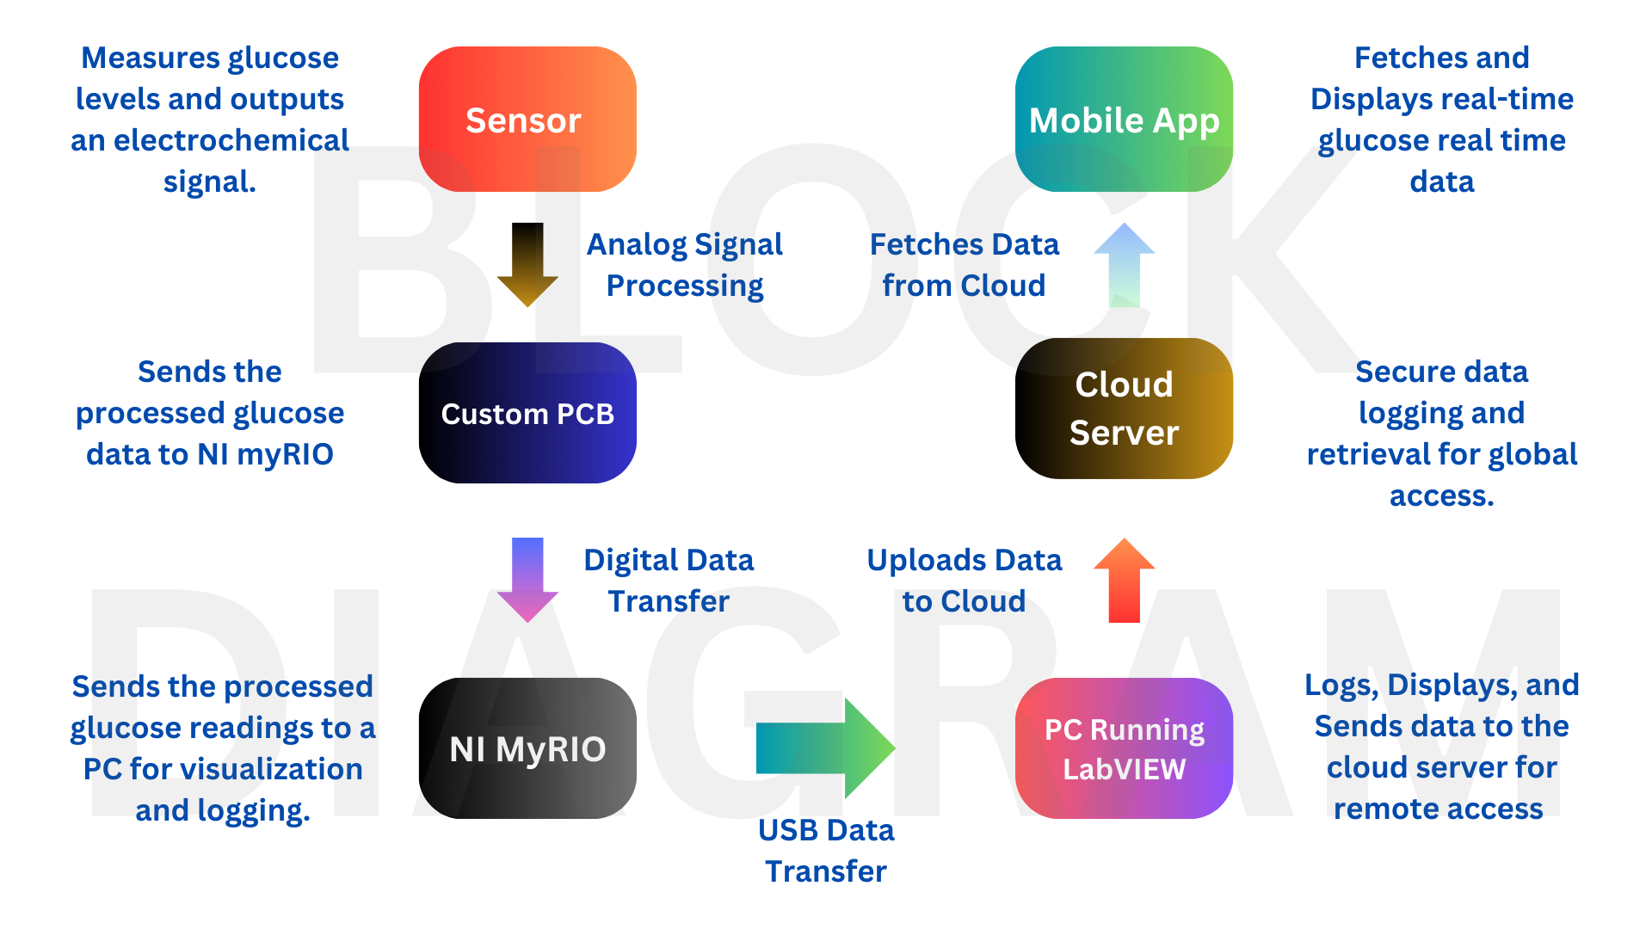
Block Diagram

Slide 6
Objectives
Develop a hardware and software system for real-time monitoring.
Enable real-time data collection and remote monitoring.
Integrate sensors, PCB, and NI myRIO for accurate data acquisition.
Implement data visualization using LabVIEW and a mobile app.
Validate the system through testing with samples.

Slide 7
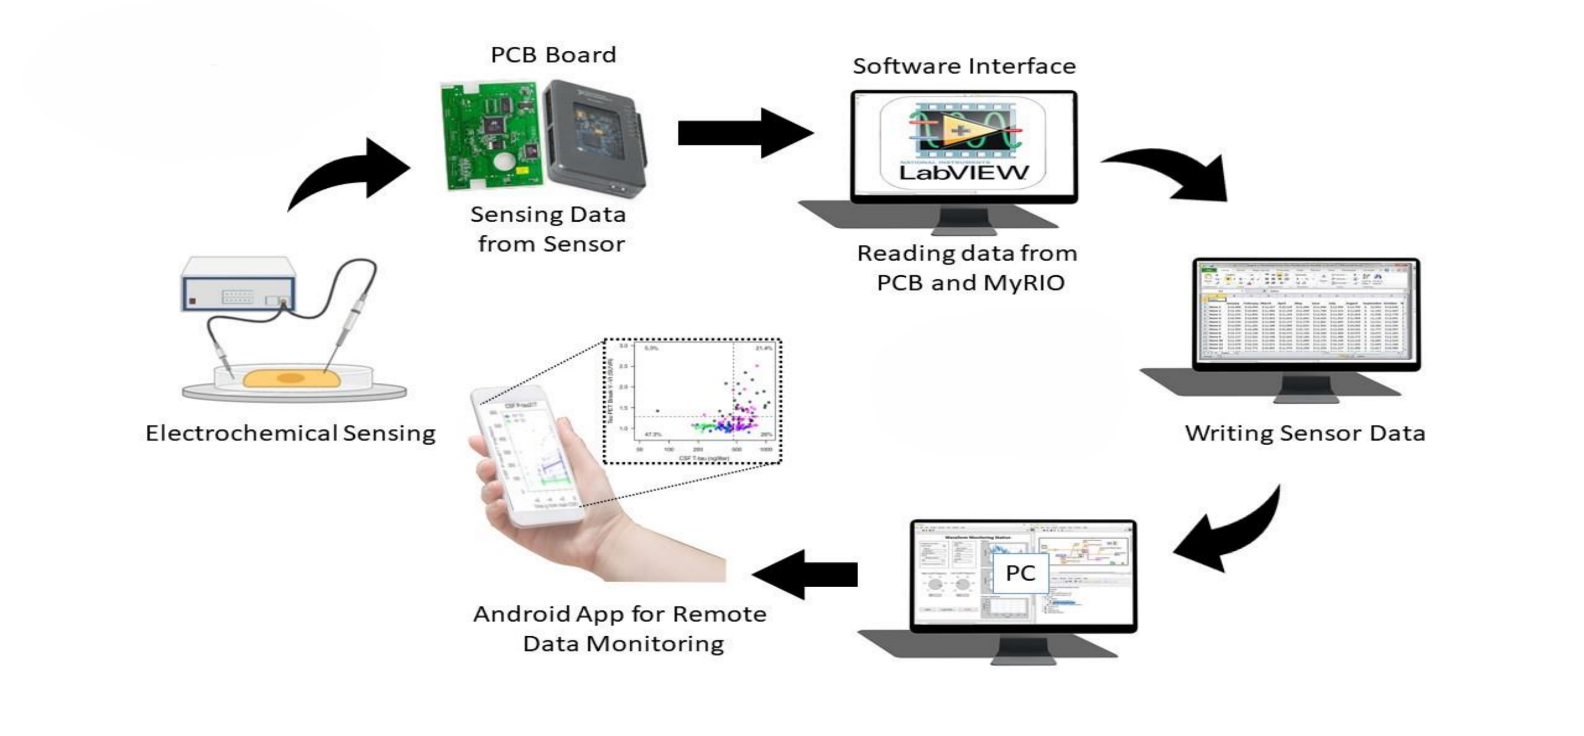
Methodology

Slide 8
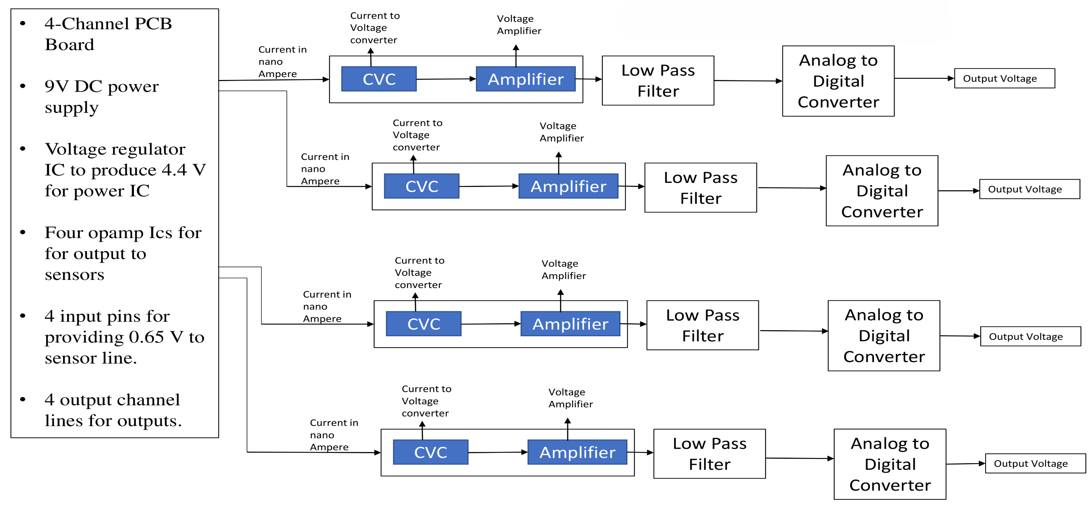
Sensor & PCB Data Processing (PCB Board)

Slide 9
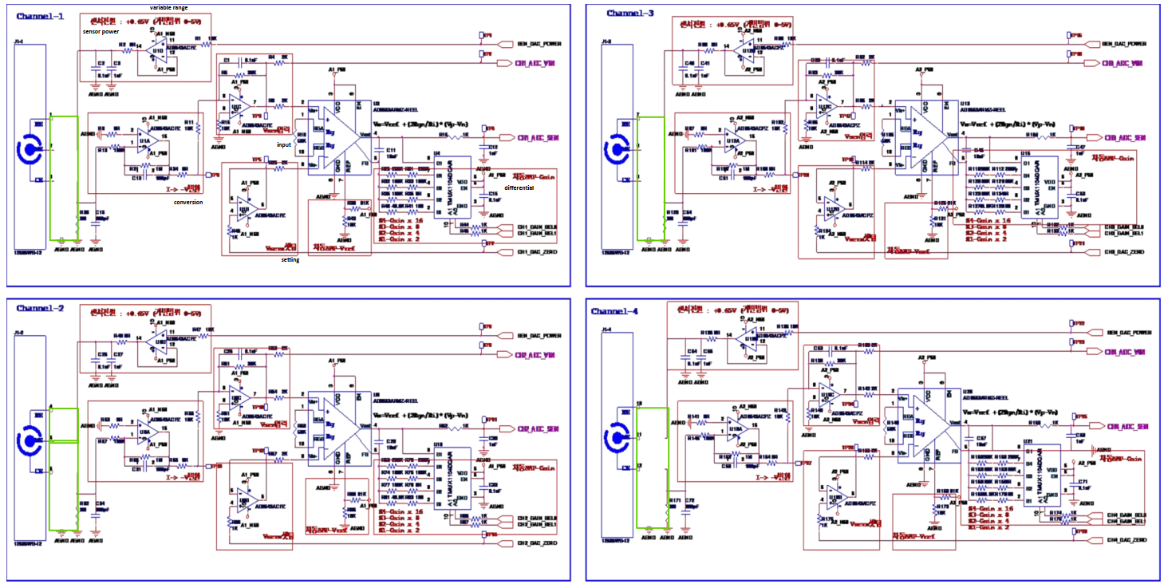
Schematic Diagram

Slide 10
Hardware & Software Components
Hardware Used:
SPE Glucose Sensor (Detects glucose).
Custom PCB (Processes sensor data).
NI myRIO (Acquires and transmits data).
PC Running LabVIEW (Visualizes & uploads data).
Software Used:
LabVIEW (Real-time monitoring & control).
Cloud Database (Stores and retrieves data).
Mobile App (Remote monitoring & notifications).

Slide 11
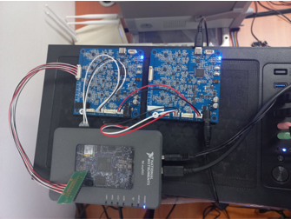
Implementation & Testing
To validate our system, we tested it with different glucose concentrations.
We calibrated the sensor and compared our results with standard glucose results.
The system successfully collected, processed, and uploaded real-time data to the cloud.

Slide 12
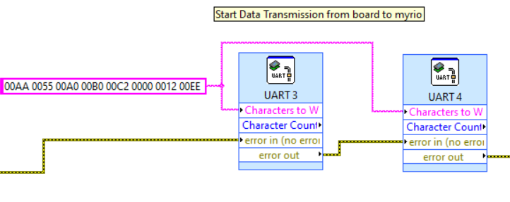
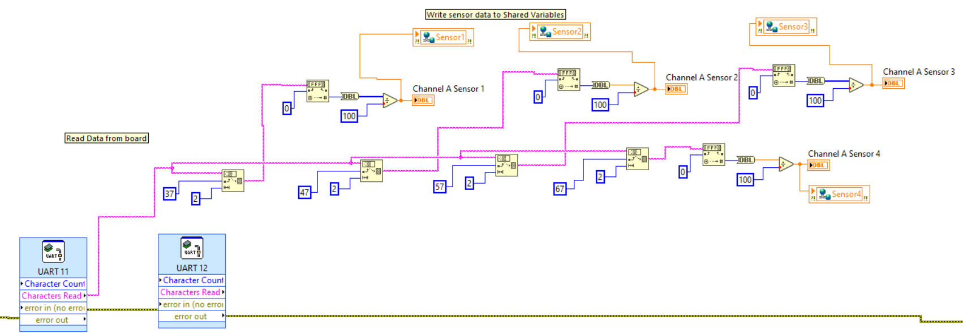
Board to NIMyrio Data Transmission

Slide 13
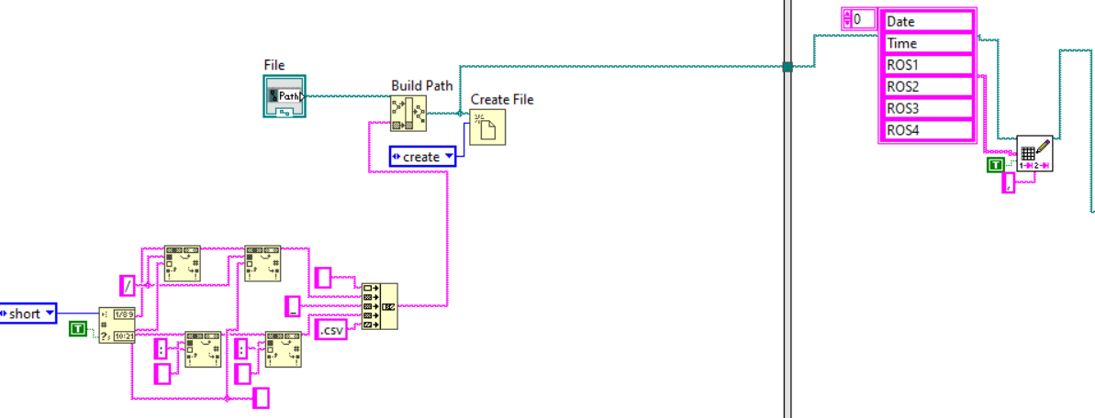
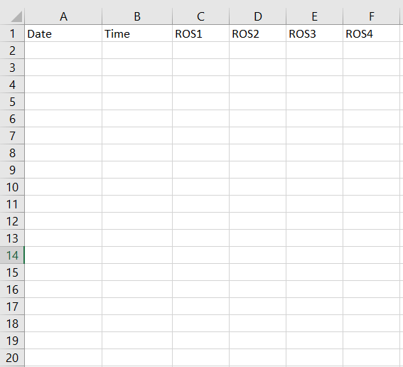
Create CSV file and Store headers

Slide 14
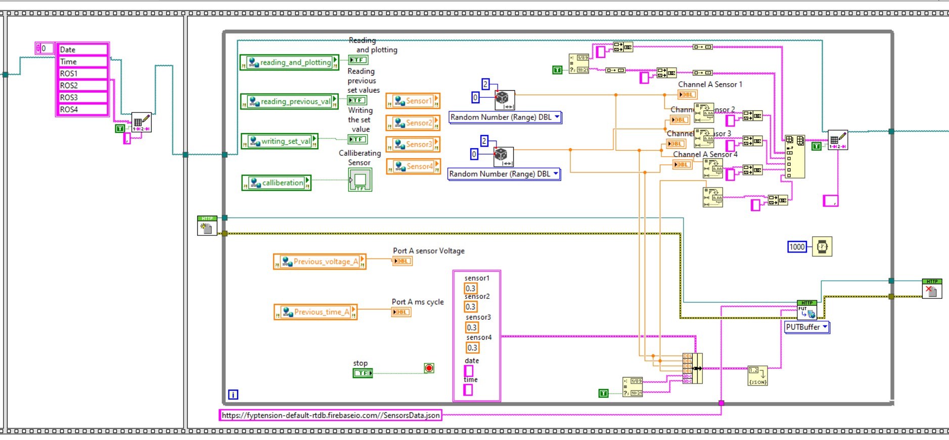
Block Diagram Of Main VI

Slide 15
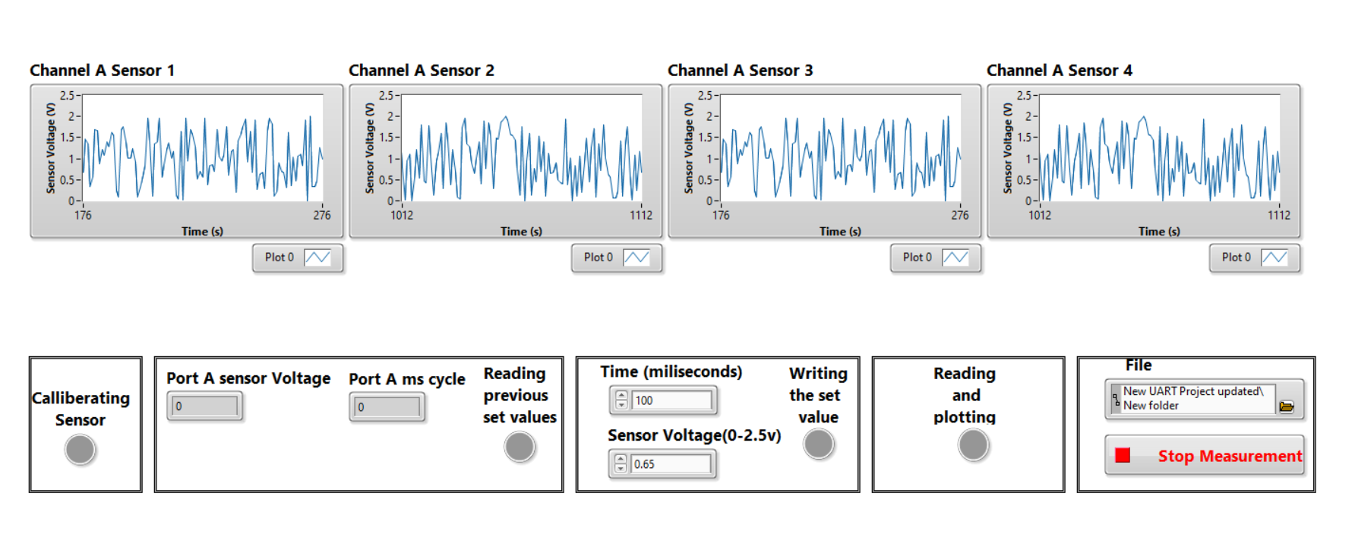
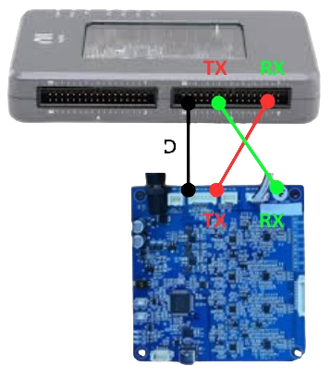

Front View of LABVIEW

Slide 16
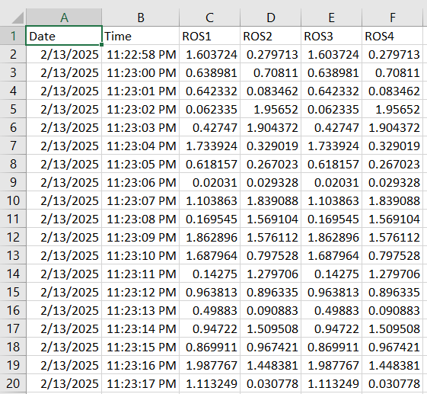
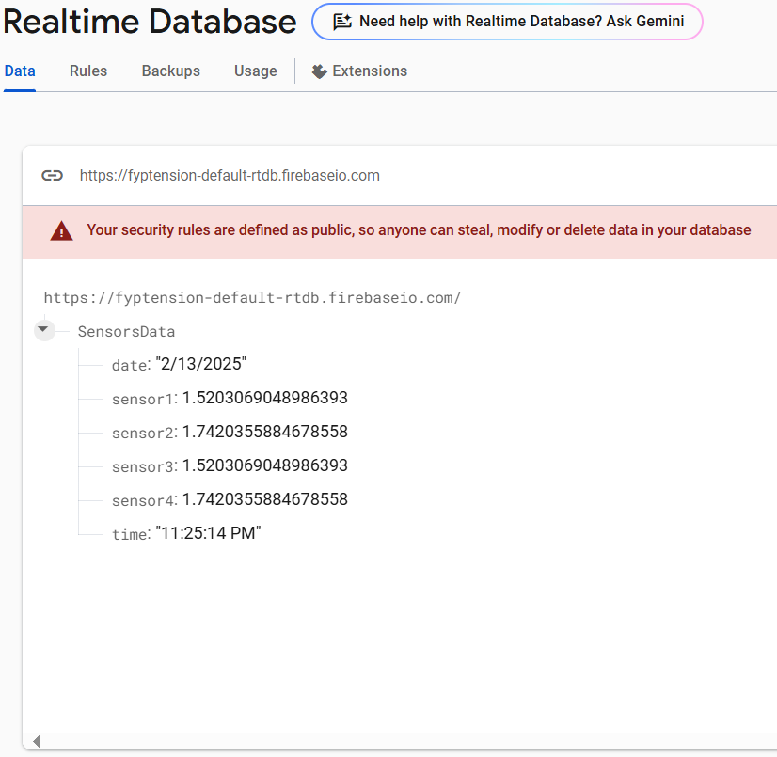
Data Stored on CSV File And Database

Slide 17
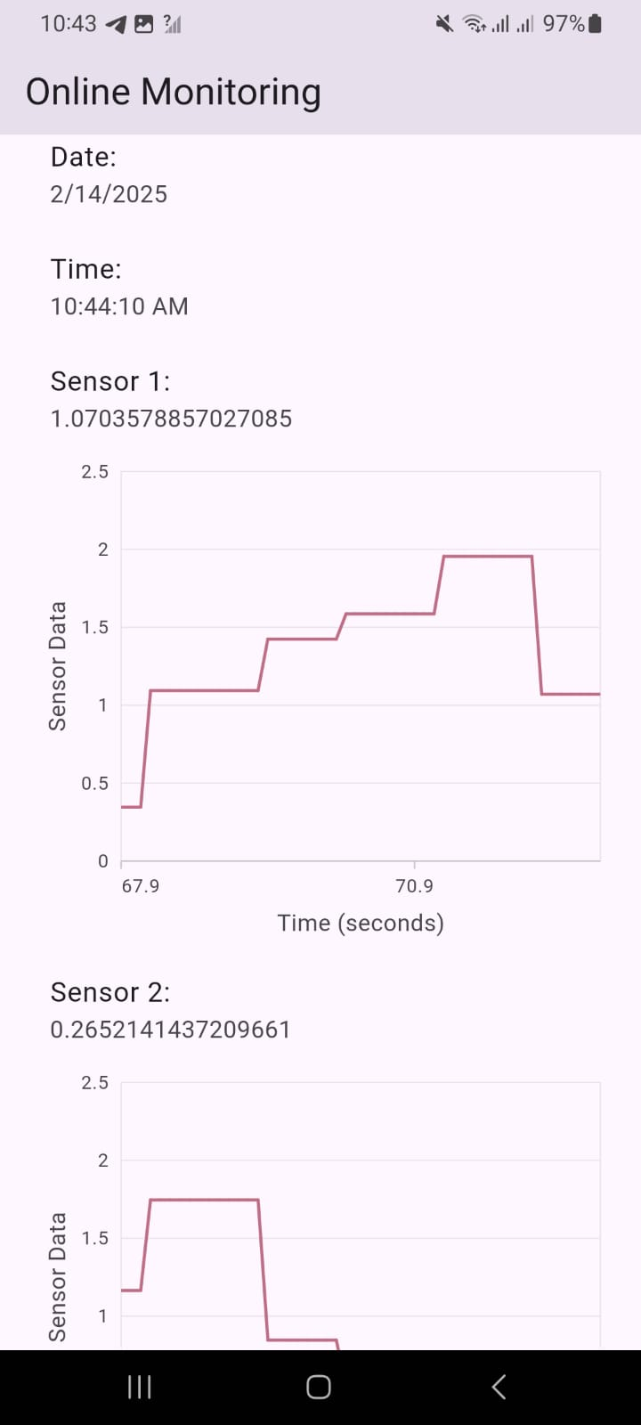
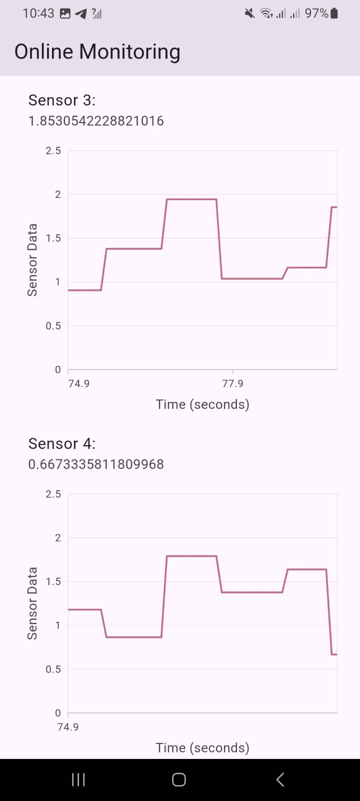
Mobile Application For Online Monitoring

Slide 18
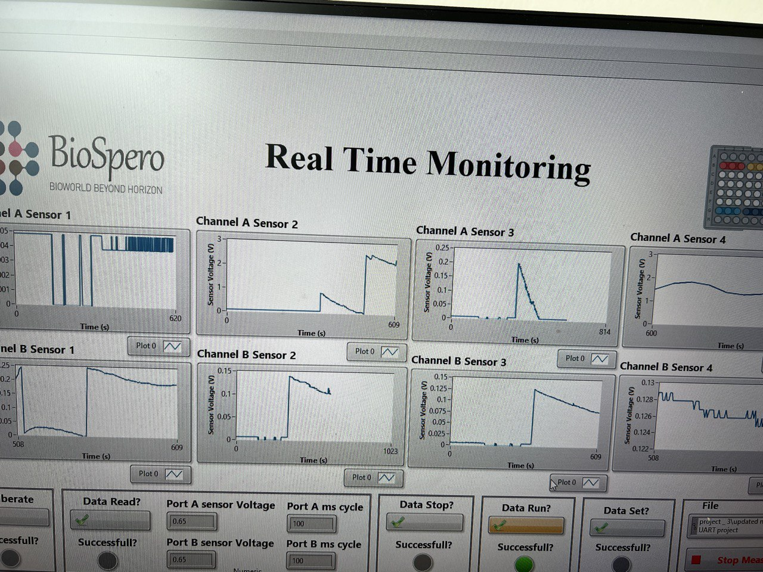
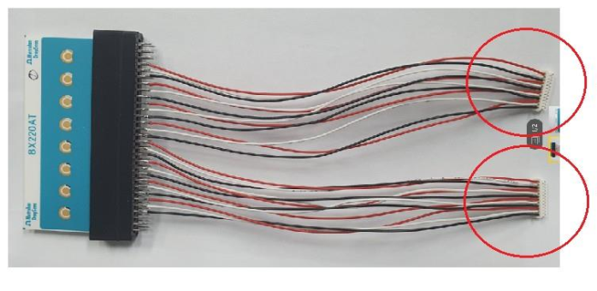
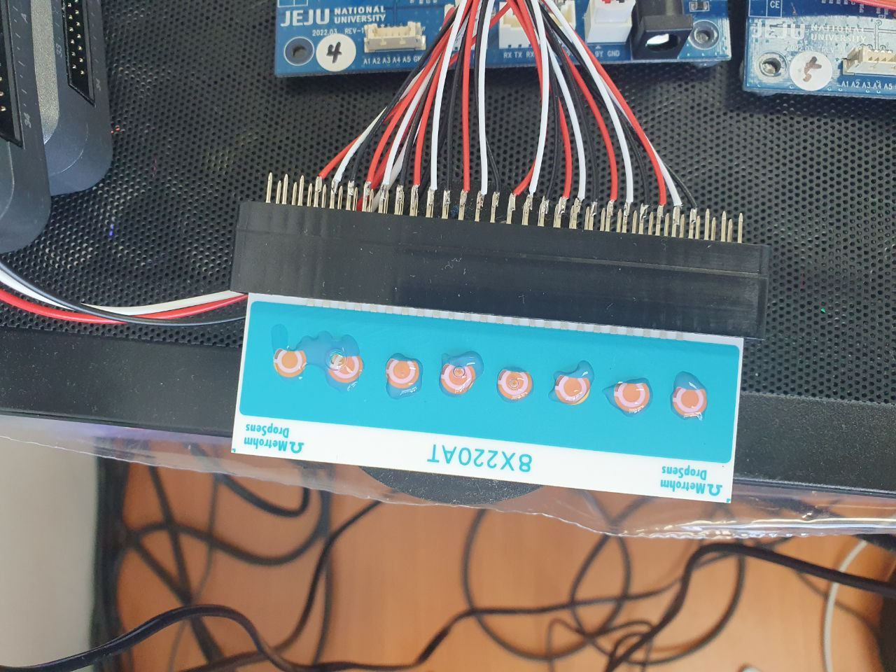
Results & Data Analysis
Channel A Sensor 3 is giving the desired response for Glucose sensing.
A filter is developed in software to adjust the transient response.
Calibration is done.
According to the PCB boards, The highlighted sensor is 2nd sensor on board 4 from the right side.
PCB Board 4 and
PCB board 5

Slide 19
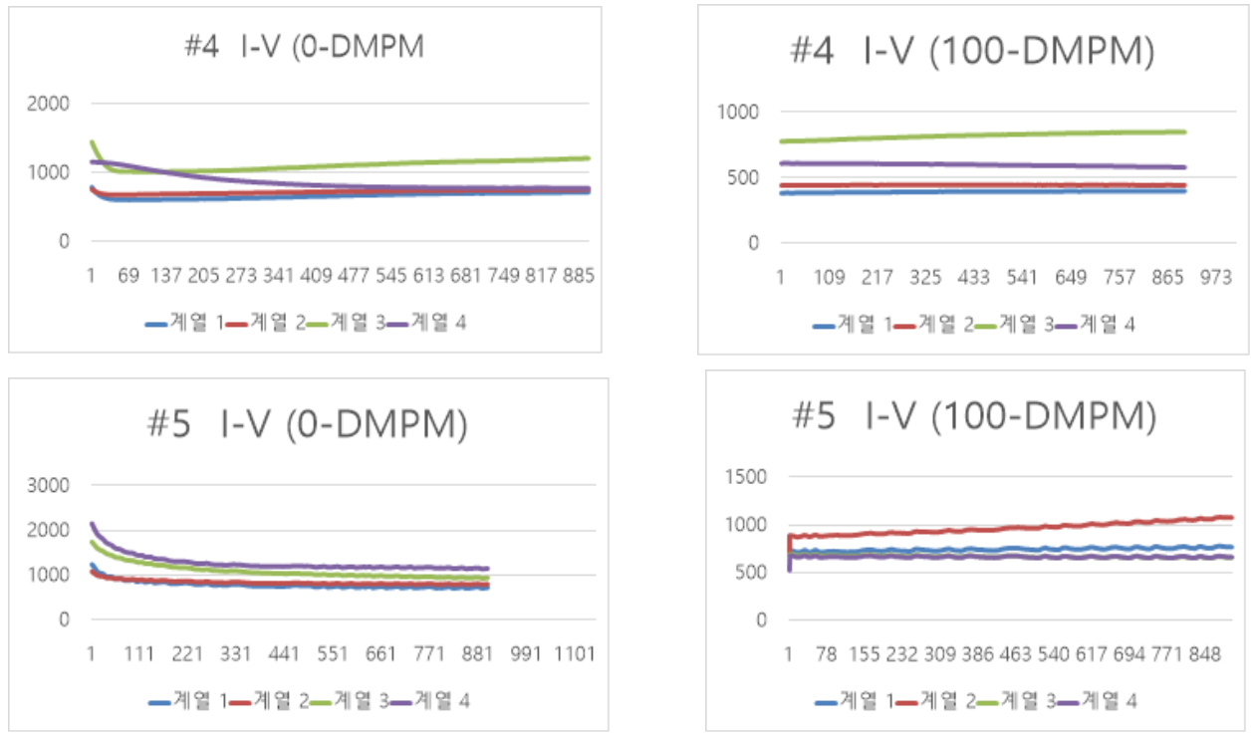
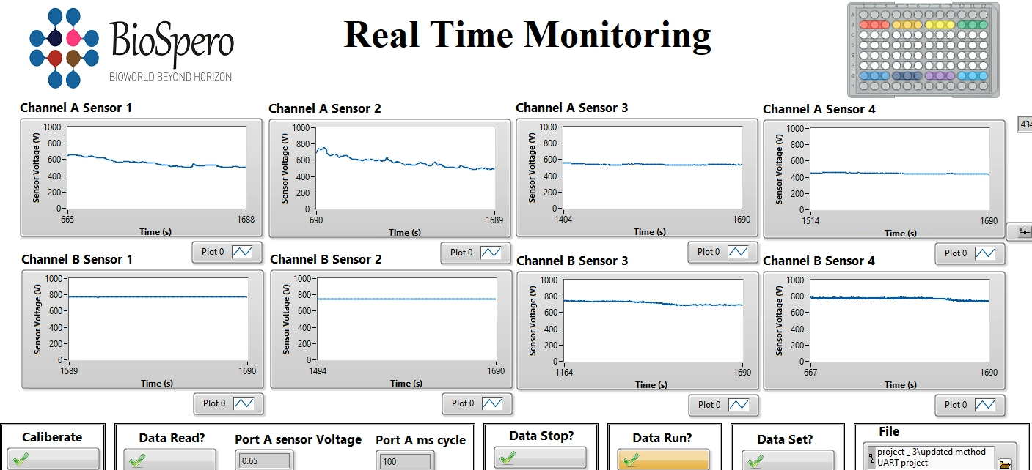
100 Micro Molar
Our Results
Company Provided Results

Slide 20
Testing 1

Slide 21
Testing 2

Slide 22
Testing 3

Slide 23
50 mM

Slide 24
10 micro-M

Slide 25
1 milli-M

Slide 26
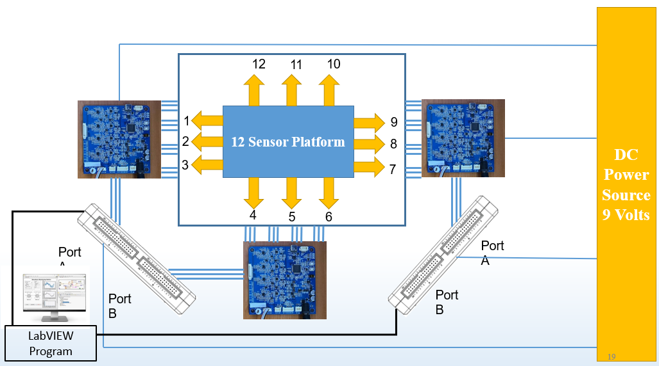
Future Work
Scale up the system to support 12 sensors.
Develop custom biosensors instead of using commercial ones.
Improve sensor calibration for higher accuracy.
Expand the system to monitor multiple biomarkers.

Slide 27
Bill of Materials (BOM)
Component Name | Quantity | Estimated Cost | Supplier/Source & Links
Screen-Printed Electrode (SPE) Glucose Sensor | 10 | PKR4,747 | shorturl.at/M4oAv
NI myRIO | 1 | PKR195,000 | https://instock.pk/national-instruments-ni-myrio-student-edition.html
Custom PCB (Fabricated) | 1 | PKR5,000 | https://instock.pk/custom-printed-circuit-board-pcb-fabrication.html
Cloud Server Subscription (Firebase/AWS) | 1 | PKR5,000 | https://firebase.google.com/
Mobile App Development Tools | 1 | PKR0 | Android Studio / React Native
Miscellanies | 10 | PKR5,000 | https://electronicshub.pk/
Total |  | PKR 214,747

Slide 28
References
S. M. Bonk, Biosensors 2015, 5, 513–536.
Q. Zhou, Lab Chip 2015, 15 (23), 4467–4478.
Y. S. Zhang, Proc. Natl. Acad. Sci. U. S. A. 2017, 114 (2), 2293–2302.
S. R. Shin, Adv. Sci. 2017, 4 (5), 1700744.
Y. I. Wang, H. E. Abaci, M. L. Shuler, Biotechnol. Bioeng. 2017, 114 (1), 184–194.
O. Y. F. Henry, R. Villenave, M. J. Cronce, W. D. Leineweber, M. A. Benz, D. E. Ingber, Lab Chip 2017, 17 (13), 2264–2271.
J. H. Sung, Anal. Chem. 2019, 91 (1), 330–351.
K. Fetah, Prog. Biomed. Eng. 2019, 1 (1), 012001.
N. Franzen, W. H. van Harten, V. P. Rete`l, P. Loskill, J. van den Eijnden-van Raaij, M. IJzerman, Drug Discov. Today 2019, 24 (9), 1720–1724.
T. Winkler, M. Feil, E. F. G. J. Stronkman, I. Matthiesen, A. Herland, Lab Chip 2020, 20 (7), 1212–1226.
H. Sun, Y. Jia, H. Dong, D. Dong, J. Zheng, Curr. Opin. Chem. Eng. 2020, 28, 1–9.
S. Fuchs, S. Johansson, A. Tjell, G. Werr, T. Mayr, M. Tenje, ACS Biomater. Sci. Eng. 2021, 7, 2926–2948.
F. H. Memon, K. Inseok, F. Ahmed, W. Ali, A. M. Soomro, S. R. Memon, K. H. Memon, K. H. Choi, ChemBioEng Rev. 2023, 10 (5), 817–828.
A. Young, K. Rivera, P. Erb, M. A. Daniele, ACS Sensors, Just Accepted Manuscript. DOI: 10.1021/acssensors.8b01549.

Slide 29

Thank You!
Any Questions?

